Slide 1
Announcements
The slides for this lecture are particularly unhelpful without consulting either the textbook or the web videos. If you feel like you’re missing something you are, see those resources instead.

Slide 2
Pre-Announcement
Project Manager at Autonomous Underwater Vehicles at Berkeley here to say “Join us for sea robots.”
Interest in AI, Machine Learning, etc.
Email auvs.at.berkeley@gmail.com

Slide 3
Quick Note on Autograders / Debugging
Autograder is not intended to be your debugging tool.
It is a bad habit to rely on teacher provided tools for correctness.
Example: Your LinkedListDeque is failing in the autograder, but works fine when you run the provided are passing LinkedListDequeTest.java file.
Approach #0: Assume the autograder is broken (unlikely but possible).
Approach #1: Visually inspect your code for errors. Sometimes works.
Approach #2: Ask for help in office hours / Piazza. OK, but slow!
Approach #3: Look inside LinkedListDequeTest.java to see how it works. Add your own tests that fail. Set breakpoints and use the visual debugger to figure out what’s going wrong.
We’ll be discussing this sort of approach today.
Notes:
6 minutes

Slide 4
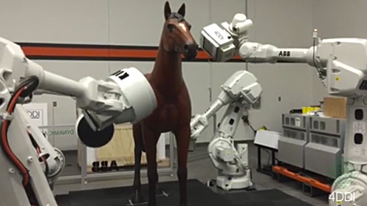
CS61B: 2018
Lecture 7: Testing
A Simple JUnit test
Testing Philosophy
Selection Sort
Simpler JUnit Tests
Notes:
http://www.vet.upenn.edu/images/default-source/news-and-events/equimagine2.jpg?sfvrsn=0

Slide 5
How Does a Programmer Know That Their Code Works?
What evidence did you have for Project 0 in 61B?
We gave you some tests.
Running main and seeing if the planets move around in a proper planetary way.
The real MVP: Autograder.
In the real world, programmers believe their code works because of tests they write themselves.
Knowing that it works for sure is usually impossible.
This will be our new way.

Slide 6

How Does a Programmer Know That Their Code Works?
What evidence did you have for Project 0 in 61B?
We gave you some tests.
Running main and seeing if the planets move around in a proper planetary way.
The real MVP: Autograder.
In the real world, programmers believe their code works because of tests they write themselves.
Knowing that it works for sure is usually impossible.
This will be our new way.

Slide 7
Sorting: The McGuffin for Our Testing Adventure
To try out this new way™, we need a task to complete.
Let’s try to write a method that sorts arrays of Strings.
x = {“he”, “is”, “the”, “agoyatis”, “of”, “mr.”, “conchis”}
public static void sort(String[] x)
x = {“agoyatis”, “conchis”, “he”, “is”, “mr.”, “of”, “the”}
Notes:
4150!

Slide 8
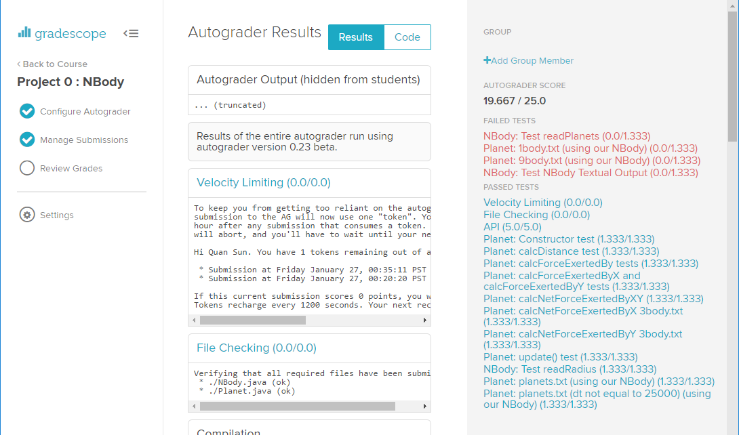
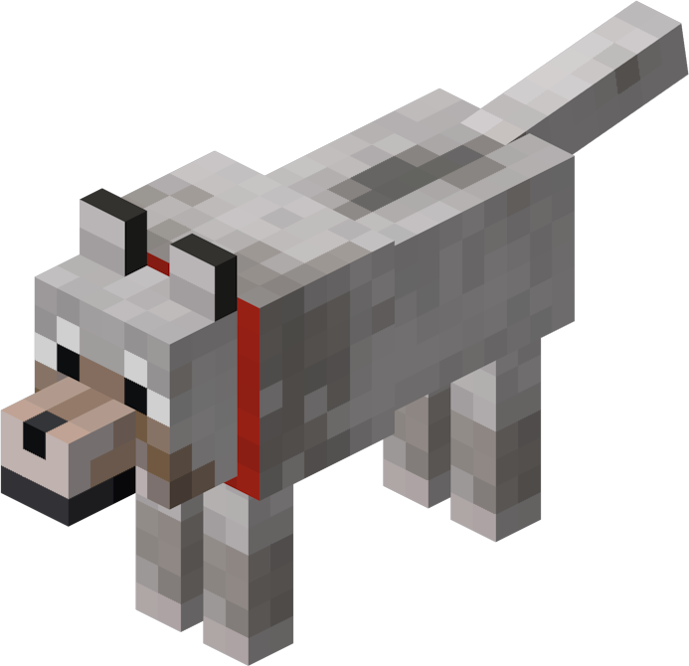
The Old Way
Autograder
public static void sort(String[] x)
Notes:
Minecraft dog

Slide 9
The New Way
In this lecture we’ll write sort, as well as our own test for sort.
Even crazier idea: We’ll start by writing testSort first!
Your Test
void testSort()
public static void sort(String[] x)
Notes:
Minecraft dog

Slide 10
Ad Hoc Testing vs. JUnit

Slide 11
Ad-Hoc Testing is Tedious
public class TestSort {
/** Tests the sort method of the Sort class. */
public static void testSort() {
String[] input = {"beware" , "of", "falling", "rocks"};
String[] expected = {"beware" , "falling", "of", "rocks"};
Sort.sort(input);
for (int i = 0; i < input.length; i += 1) {
if (!input[i].equals(expected[i])) {
System.out.println("Mismatch at position " + i + ", expected: '" + expected[i] +
"', but got '" + input[i] + "'");
return;
}
}
}
public static void main(String[] args) {
testSort();
}
}
JUnit saves us the trouble of writing code like this (and more!).
public static void sort(String[] inputs)
Notes:
Minecraft dog

Slide 12
JUnit: A Library for Making Testing Easier (example below)
public class TestSort {
/** Tests the sort method of the Sort class. */
public static testSort() {
String[] input = {"cows", "dwell", "above", "clouds"};
String[] expected = {"above", "cows", "clouds", "dwell"};
Sort.sort(input);
org.junit.Assert.assertArrayEquals(expected, input);
}
public static void main(String[] args) {
testSort();
}
}
public static void sort(String[] inputs)
Notes:
Minecraft dog

Slide 13
Selection Sort

Slide 14
Back to Sorting: Selection Sort
Selection sorting a list of N items:
Find the smallest item.
Move it to the front.
Selection sort the remaining N-1 items (without touching front item!).
*
6
3
7
2
8
1
1
3
7
*
2
8
6
1
2
7
*
3
8
6
*
1
2
3
7
8
6
1
2
3
6
8
*
7
1
2
3
6
7
8
As an aside: Can prove correctness of this sort using invariants.
Notes:
20 minutes to get here going slow.

Slide 15
Back to Sorting: Selection Sort
Selection sorting a list of N items:
Find the smallest item.
Move it to the front.
Selection sort the remaining N-1 items (without touching front item!).
*
Let’s try implementing this.
I’ll try to simulate as closely as possible how I think students might approach this problem to show how TDD helps.
Not shown in details in these slides. See lecture video.
6
3
7
2
8
1
1
3
7
*
2
8
6
1
2
7
*
3
8
6
*
1
2
3
7
8
6
1
2
3
6
8
*
7
1
2
3
6
7
8
Notes:
20 minutes to get here going slow.

Slide 16
The Evolution of Our Design
Created testSort:
Created a sort skeleton:
Created testFindSmallest:
Created findSmallest:
Created testSwap:
Created swap:
Changed findSmallest:
testSort()
Used Google to figure out how to compare strings.
sort(String[] inputs)
testFindSmallest()
String findSmallest(String[] input)
testSwap()
Used debugger to fix.
swap(String[] input, int a, int b)
int findSmallest(String[] input)
Now we have all the helper methods we need, as well as tests that make us pretty sure that they work! All that’s left is to write the sort method itself.
Notes:
20 minutes to get here going slow.

Slide 17
Very Tricky Problem
method signature
Without changing the signature of public static void sort(String[] a), how can we use recursion? What might the recursive call look like?
public static void sort(String[] x) {
int smallest = findSmallest(x);
swap(inputs, 0, smallest);
// recursive call??
}
Notes:
35 total minutes
http://watchout4snakes.com/wo4snakes/Random/RandomPhrase

Slide 18
Very Tricky Problem: Bad But Tempting Solution
method signature
Without changing the signature of public static void sort(String[] a), how can we use recursion? What might the recursive call look like?
Some languages support sub-indexing into arrays. Java does not.
Bottom line: No way to get address of the middle of an array.
public static void sort(String[] x) {
int smallest = findSmallest(x);
swap(inputs, 0, smallest);
sort(x[1:]); ← Would be nice, but not possible!
}
Notes:
35 total minutes
http://watchout4snakes.com/wo4snakes/Random/RandomPhrase

Slide 19
Very Tricky Problem: Good Solution
method signature
Without changing the signature of public static void sort(String[] a), how can we use recursion? What might the recursive call look like?
public static void sort(String[] x) {
sort(x, 0);
}
/** Destructively sorts x starting at index k */
public static void sort(String[] x, int k) {
...
sort(x, k + 1);
}
Notes:
35 total minutes
http://watchout4snakes.com/wo4snakes/Random/RandomPhrase

Slide 20
Major Design Flaw in findSmallest
We didn’t properly account for how findSmallest would be used.
Example: Want to find smallest item from among the last 4:
We need another parameter so that it’s actually useful for sorting.
1
2
7
*
3
8
6
Notes:
35 total minutes
http://watchout4snakes.com/wo4snakes/Random/RandomPhrase

Slide 21
The Evolution of our Design
Created testSort:
Created a sort skeleton:
Created testFindSmallest:
Created findSmallest:
Created testSwap:
Created swap:
Changed findSmallest:
Added helper method:
Used debugger to realize fundamental design flaw in findSmallest
testSort()
Used Google to figure out how to compare strings.
sort(String[] inputs)
testFindSmallest()
String findSmallest(String[] input)
testSwap()
Used debugger to fix.
swap(String[] input, int a, int b)
int findSmallest(String[] input)
sort(String[] inputs, int k)
Notes:
20 minutes to get here going slow.

Slide 22
The Evolution of our Design
Created testSort:
Created a sort skeleton:
Created testFindSmallest:
Created findSmallest:
Created testSwap:
Created swap:
Changed findSmallest:
Added helper method:
Used debugger to realize fundamental design flaw in findSmallest
Modified findSmallest:
testSort()
Used Google to figure out how to compare strings.
sort(String[] inputs)
testFindSmallest()
String findSmallest(String[] input)
testSwap()
Used debugger to fix.
swap(String[] input, int a, int b)
int findSmallest(String[] input)
sort(String[] inputs, int k)
int findSmallest(String[] input, int k)
Notes:
20 minutes to get here going slow.

Slide 23
And We’re Done!
Often, development is an incremental process that involves lots of task switching and on the fly design modification.
Tests provide stability and scaffolding.
Provide confidence in basic units and mitigate possibility of breaking them.
Help you focus on one task at a time.
In larger projects, tests also allow you to safely refactor! Sometimes code gets ugly, necessitating redesign and rewrites (see project 2).
One remaining problem: Sure was annoying to have to constantly edit which tests were running. Let’s take care of that.

Slide 24
Simpler JUnit Tests
(using two new syntax tricks)

Slide 25
Simple JUnit
New Syntax #1: org.junit.Assert.assertEquals(expected, actual);
Tests that expected equals actual.
If not, program terminates with verbose message.
We’ve already seen this throughout today.
JUnit does much more:
Other methods like assertEquals include assertFalse, assertNotNull, etc., see http://junit.org/junit4/javadoc/4.12/org/junit/Assert.html
Other more complex behavior to support more sophisticated testing.
See lab3.

Slide 26
Better JUnit
The messages output by JUnit are kind of ugly, and invoking each test manually is annoying.
New Syntax #2 (just trust me):
Annotate each test with @org.junit.Test.
Change all test methods to non-static.
Use a JUnit runner to run all tests and tabulate results.
IntelliJ provides a default runner/renderer. OK to delete main.
If you want to use the command line instead, see the jh61b runner in the lab 3 supplement. Not preferred.
Rendered output is easier to read, no need to manually invoke tests!
There is a lot of black magic happening here! Just accept it all for now.
Yes this is weird, as it implies you’d be instantiating TestSort.java. In fact, JUnit runners do this. I don’t know why.

Slide 27
Even Better JUnit
It is annoying to type out the name of the library repeatedly, e.g. org.junit.Test and org.junit.Assert.assertEquals.
New Syntax #3: To avoid this we’ll start every test file with:
import org.junit.Test; import static org.junit.Assert.*;
This will magically eliminate the need to type ‘org.junit’ or ‘org.junit.Assert’ (more after the midterm on what these imports really mean).

Slide 28
Testing Philosophy
(Web Video Only)

Slide 29
Correctness Tool #1: Autograder
Idea: Magic autograder tells you code works.
We use JUnit + jh61b libraries.
Why?
Less time wasted on “boring” stuff.
Determines your grade.
Gamifies correctness.
Why not?
Autograders don’t exist in real world.
Errors may be hard to understand.
Slow workflow.
No control if grader breaks / misbehaves.
Autograder
sort

Slide 30
Autograder Driven Development (ADD)
The worst way to approach programming:
Read and (mostly) understand the spec.
Write entire program.
Compile. Fix all compilation errors.
Send to autograder. Get many errors.
Until correct, repeat randomly:
Run autograder.
Add print statements to zero in on the bug.
[63, 12, 91, 5, 0]
got to this spot, lt is: 1
got to this spot, lt is: 2
got here!
[63, 12, 0, 5, 91]
got to this spot, lt is: 3
got to this spot, lt is: 4
got here!
[5, 12, 0, 63, 91]
Test Failed. Expected: ...
Make changes to code to try to fix bug.
This workflow is slow and unsafe!
Note: Print statements are not inherently evil. While they are a weak tool, they are very easy to use.

Slide 31
Correctness Tool #2: Unit Tests
Idea: Write tests for every “unit”.
JUnit makes this easy!
Why?
Build confidence in basic modules.
Decrease debugging time.
Clarify the task.
Why not?
Building tests takes time.
May provide false confidence.
Hard to test units that rely on others.
e.g. how do you test addFirst?
testSort
sort
swap
findSmallest
testSwap
testFindSmallest
Notes:
11 minutes showing good way to test, not including this slide.

Slide 32
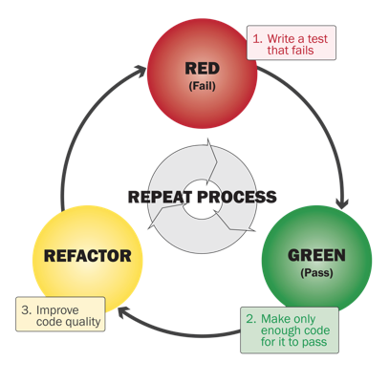
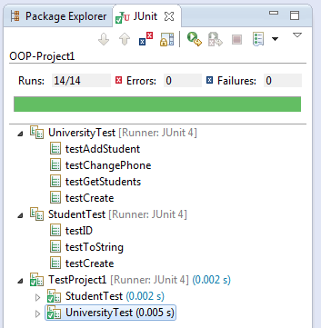
Test-Driven Development (TDD)
Steps to developing according to TDD:
Identify a new feature.
Write a unit test for that feature.
Run the test. It should fail. (RED)
Write code that passes test. (GREEN)
Implementation is certifiably good!
Optional: Refactor code to make it faster, cleaner, etc.
Not required in 61B. You might hate this!
But testing is a good idea.
Interesting perspective: Red-Shirt, Red, Green, Refactor.

Slide 33
A Tale of Two Workflows
TDD is an extreme departure from the naive workflow.
What’s best for you is probably in the middle.
$ python sort.py
[63, 12, 91, 5, 0]
got to this spot, lt is: 1
got to this spot, lt is: 2
got here!
[63, 12, 0, 5, 91]
got to this spot, lt is: 3
got to this spot, lt is: 4
got here!
[5, 12, 0, 63, 91]

Slide 34

Correctness Tool #3: Integration Testing
Idea: Tests cover many units at once.
Not JUnit’s focus, but JUnit can do this.
addFirst
addLast
Why?
Unit testing is not enough to ensure modules interact properly or that system works as expected.
Why not?
Can be tedious to do manually.
Can be challenging to automate.
Testing at highest level of abstraction may miss subtle or rare errors.
size
isEmpty
...
...
ArrayDeque
Some sort of script in Java, Python, etc.
Automatic
Manual
Notes:
https://thumbs.dreamstime.com/x/business-person-eating-pizza-computer-8427611.jpg

Slide 35
Parting Thoughts
JUnit makes testing easy.
You should write tests.
But not too many.
Only when they might be useful!
Write tests first when it feels appropriate [I do this a lot].
Lab 3, Project 1B, and Project 2 will give you practice!
Most of the class won’t require writing lots of tests (to save you time).
Some people really like TDD. Feel free to use it in 61B.
See today’s optional reading for thoughts from the creator of Ruby on Rails and others.

Slide 36
More On JUnit (Extra)

Slide 37
Bonus Slide: What is an Annotation?
Annotations (like org.junit.Test) don’t do anything on their own.
Runner uses reflections library to iterate through all methods with “Test” annotation. Pseudocode on next slide.
@Test
public void testSort() {
...
}

Slide 38
Sample Runner Pseudocode
Runner uses reflections library to iterate through all methods with “Test” annotation.
List<Method> L = getMethodsWithAnnotation(TestSort.class,
org.junit.Test);
int numTests = L.size();
int numPassed = 0;
for (Method m : L) {
result r = m.execute();
if (r.passed == true) { numPassed += 1; }
if (r.passed == false) { System.out.println(r.message); }
}
System.out.println(numPassed + “/” + numTests + “ passed!”);

Slide 39
Citations
Training montage: Wet Hot American Summer
Creepy hand picture (title slide): http://www.automatedtestinginstitute.com/home/images/stories/Functional.jpg
Red-Green-Refactor image courtesy of a guy who has had issues with TDD: http://ryantablada.com/post/red-green-refactor---a-tdd-fairytale

Slide 40
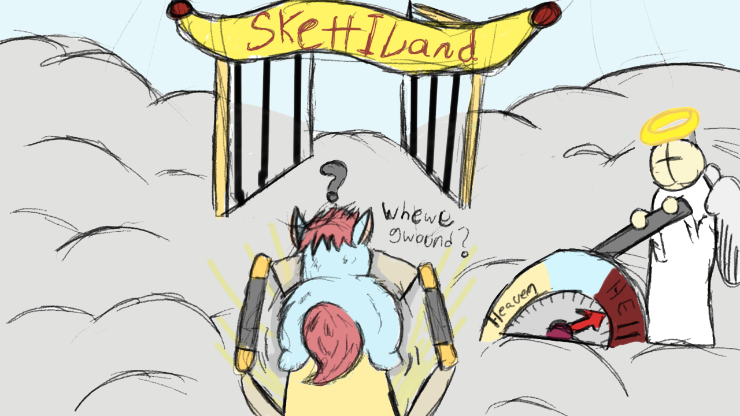
How It Usually Goes...
Autograder
public static void sort(String[] inputs)
Notes:
https://www.fluffybooru.org/post/view/40111

